Slide 1


RADIAN Subsystem Demo Team 60 - Group 3 Matthew Blackwell, Mitch Hoffman, Wyatt Johnson Sponsor: Dr. Arya Menon

Slide 2

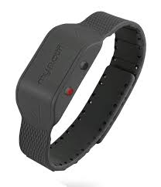
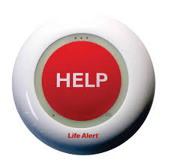
Problem Statement
Falls are the leading cause of injury in elderly
Fast detection saves lives through quick response
Current Solutions - Limitations:
Wearables → must be worn and charged
Push-buttons → user must be conscious/able to press
Camera → effective but invade privacy

Slide 3
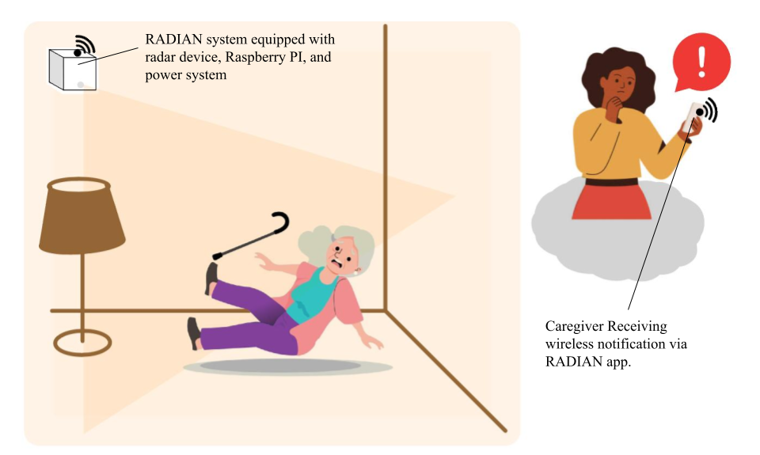
RADIAN System Summary
Proposed Solution:
Automatic Fall Detection
Works in real time
No user action needed
Privacy-Preserving
No camera
Protects independence
Reliable Response
Immediate accurate alerts to caregivers

Slide 4
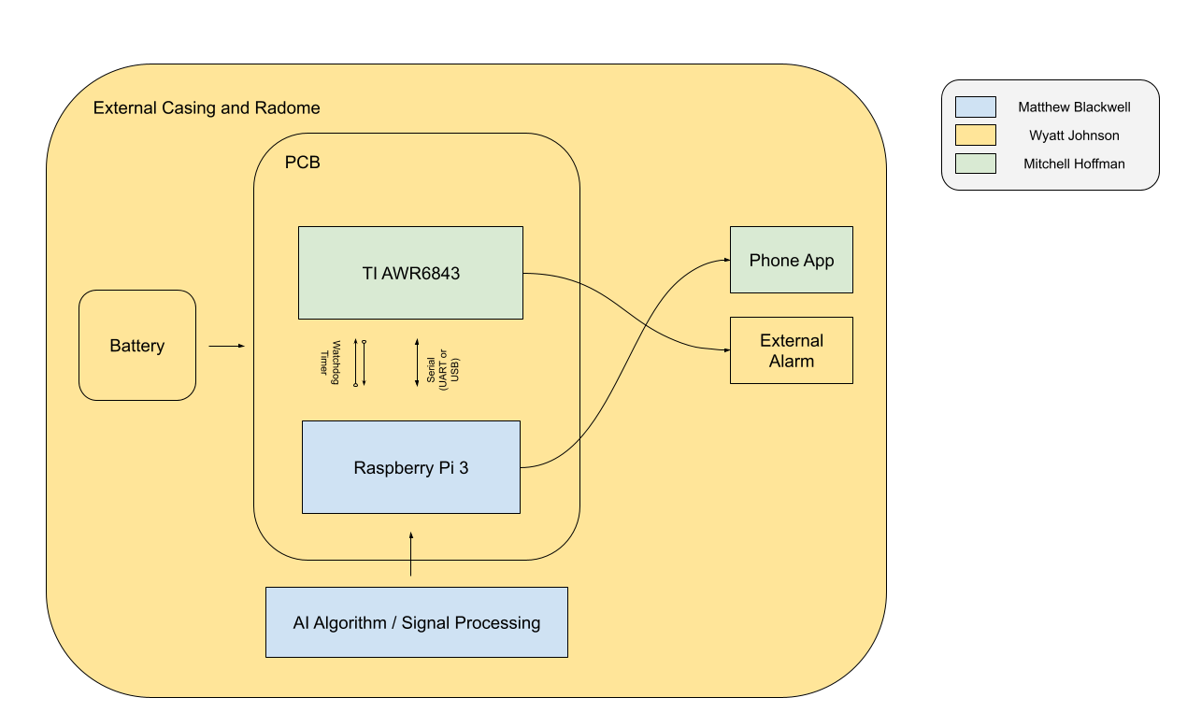
System Overview

Slide 5
Data Technical Merit
Overview:
Create a ML model to detect falls for elderly and high-risk individuals
403 Assumptions:
The elderly move at an average rate of 0.45 m/s, only one individual in the scanned room, an average range of z (height) of 1.2m - 1.7m
RADIAN Pipeline:
Edgecase Generator → Classifier → Fall Detection Logic → Output

Slide 6
Data Validation
Edgecase Generator:
Built an 8 case edgecase generator for common potential “false positives” including sitting down, bending over, kneeling, laying down, crawling, a pet walking through the frame, an object dropping, and a true hard fall.
These 8 cases are used to prove that the system works as intended, simulating both positive and negative falls to ensure that the ML model predicts correctly.

Slide 7
Data Classifier and Logic
Classifier:
Adds AWGN, jitter, mixed movement speeds, and other common factors to the synthesized data to mimic actual radar data from the AWR6843.
Classifies based on a movement score calculated on indicators such as a high velocity, sudden z-axis movement changes, and random “false positive” noise. This allows for the model to not only train on |v| > 0.4 as movement, but also confirms with x,y, and z movement shifts.

Slide 8
Data Classifier and Logic
Logic:
A fall is detected when both of these conditions are true:
z_drop (average) > 0.3 meters
static_ratio > 0.5
The average z value is taken over the previous 5 frames, where the fall is thought to have been detected, and if at least 50% of the points become static after the individual hits the ground.

Slide 9
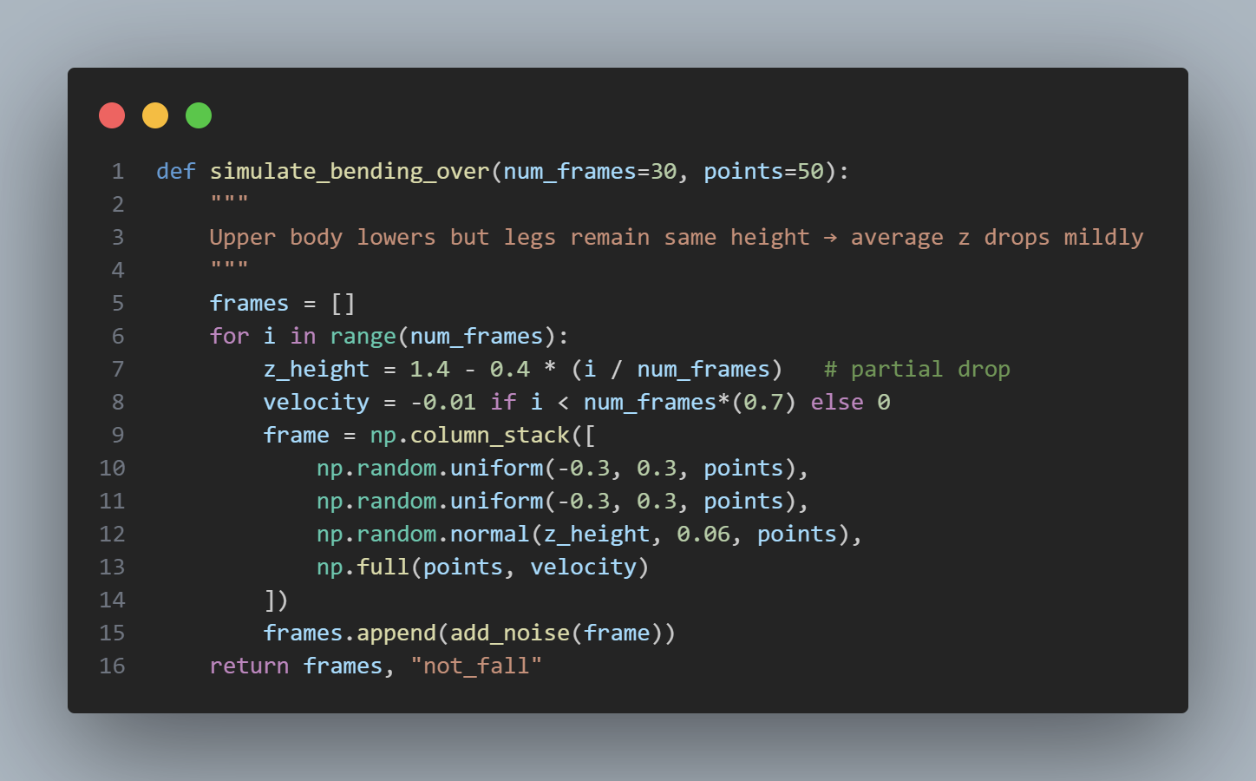
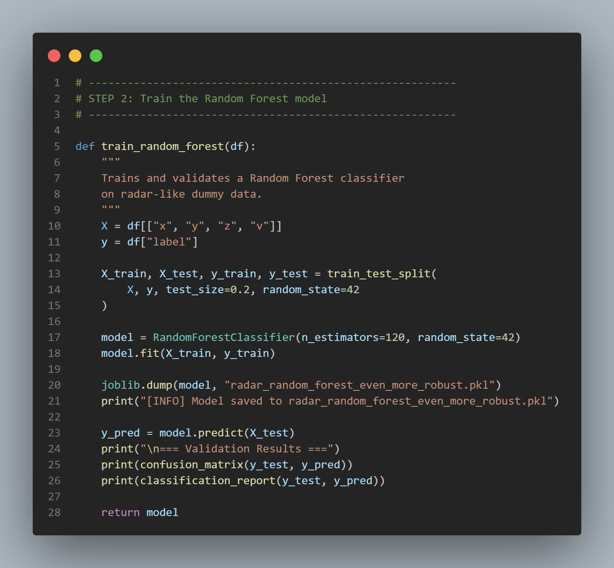
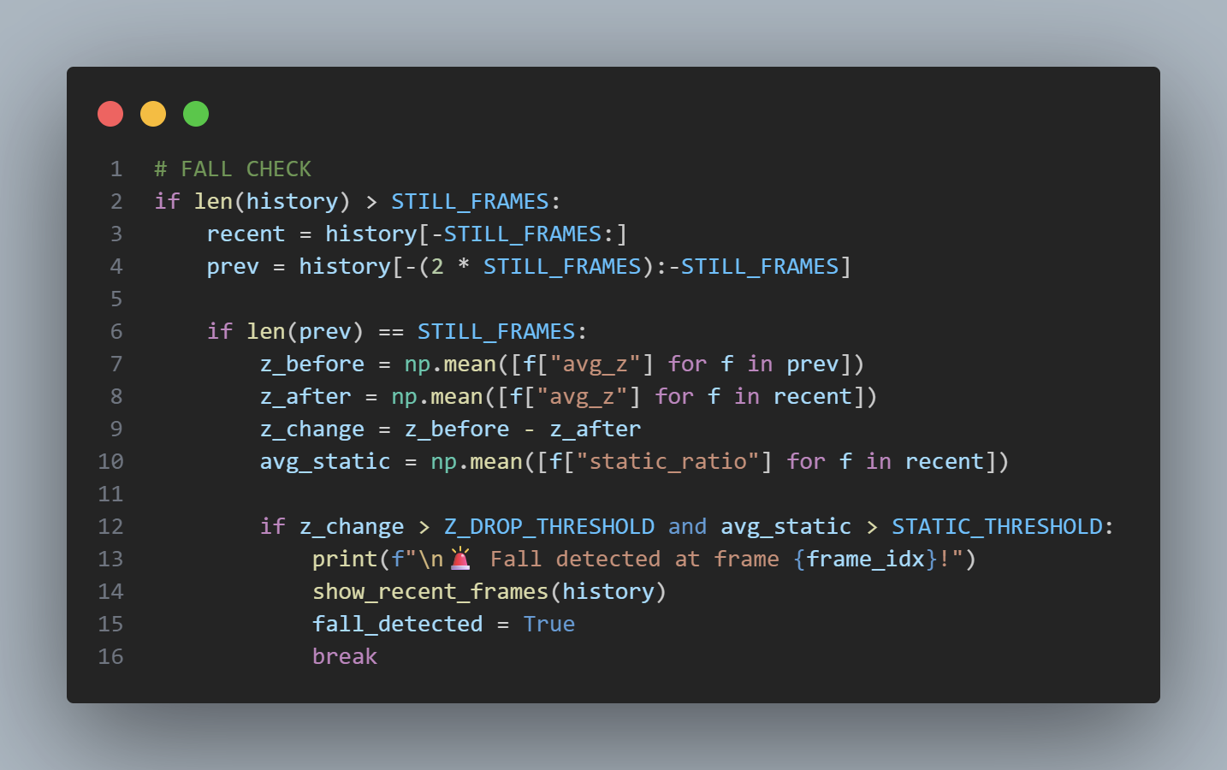
Data Code Snippets
Image 1: Example of edgecase generating function, specifically for simulating “bending over”
Image 2: Code block for training the random forest model
Image 3: The logic for the fall check

Slide 10
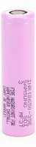
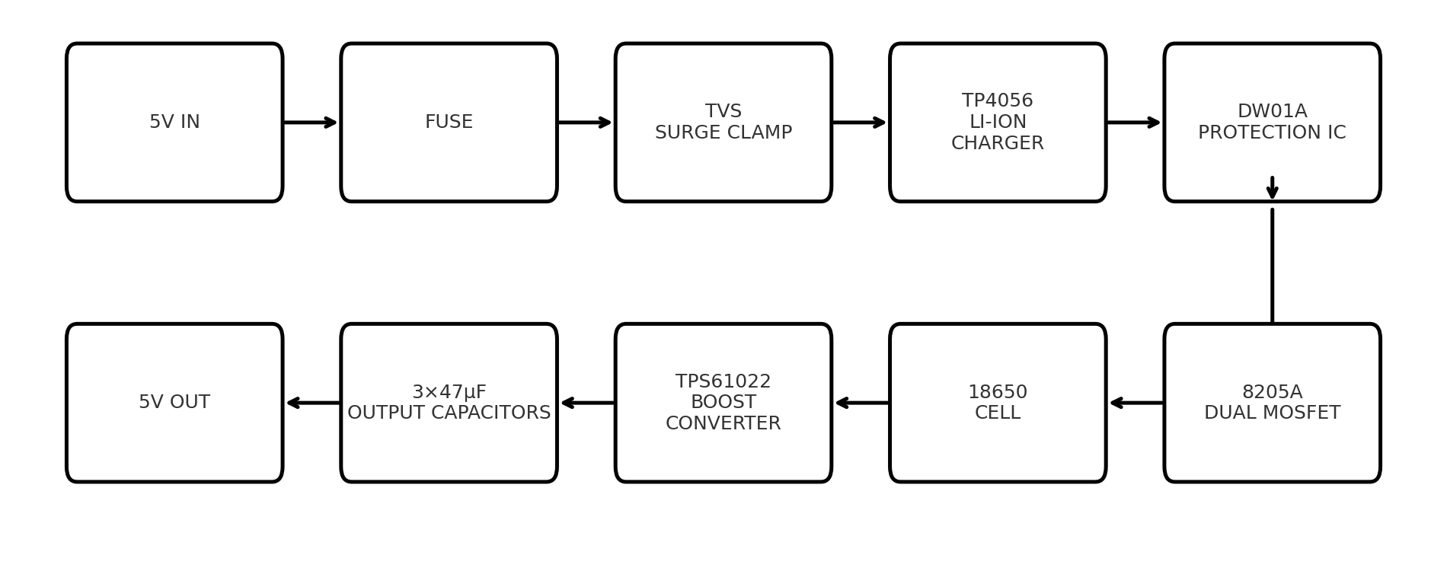
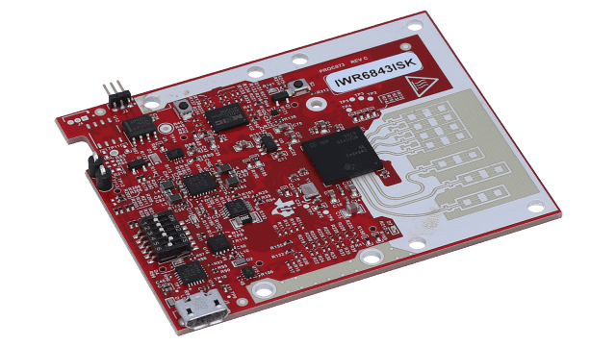
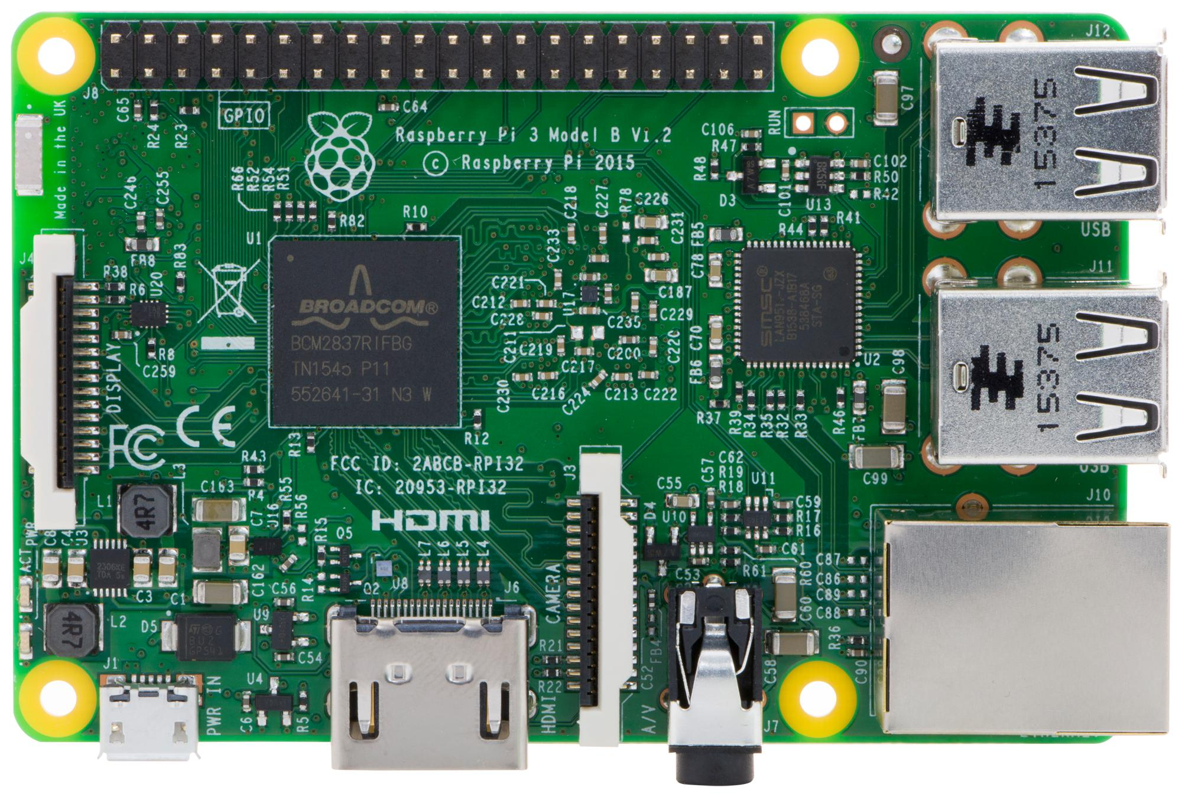
Physical – Wyatt Johnson
Power & Battery Subsystem:
Subsystem function:
Provide power, battery protection, and charging
Design Overview:
Batteries
Power conversion
Cadence
Power Budget:
5V/1A — Radar
5V/1A — Raspberry PI
3.7v 3500mAh

Slide 11
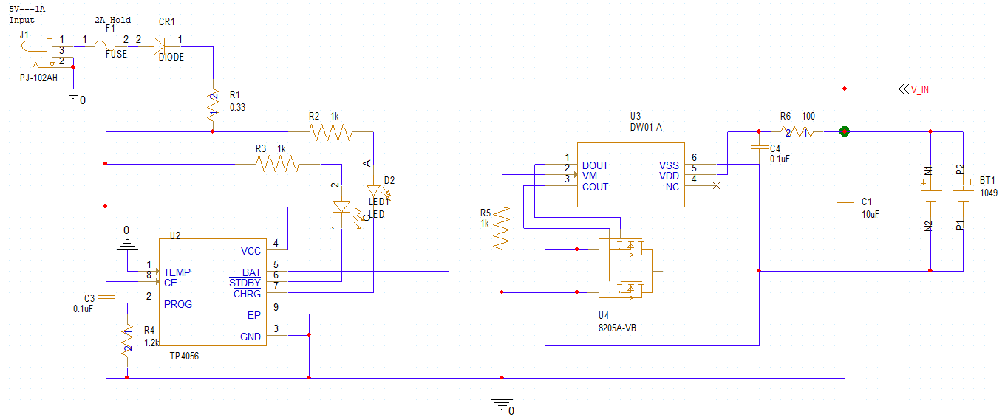
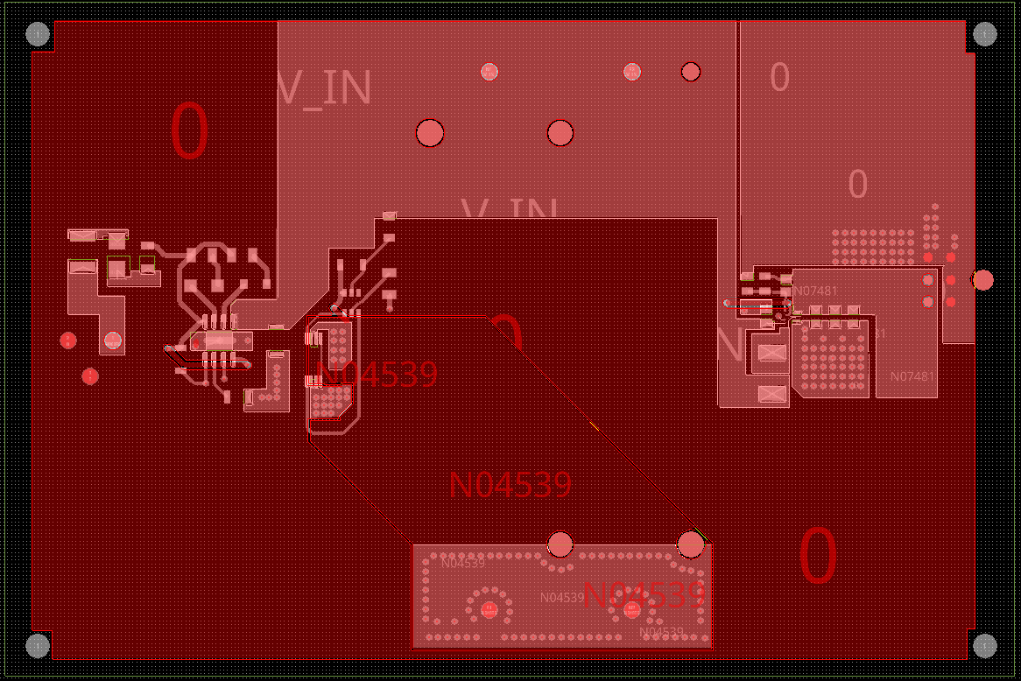
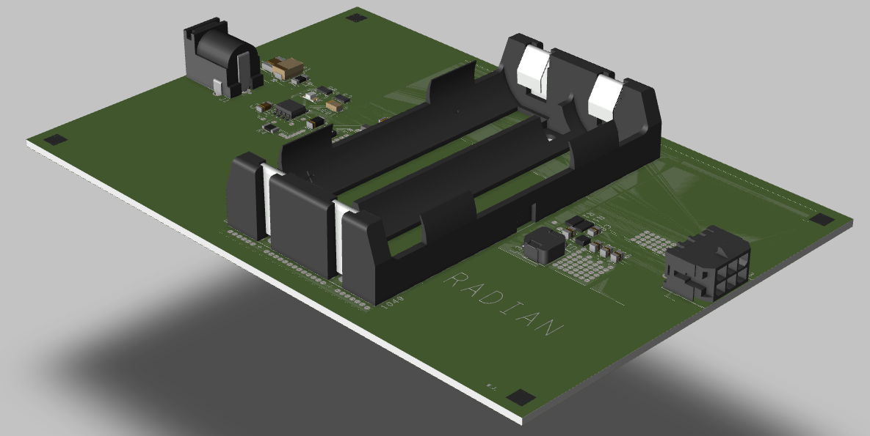
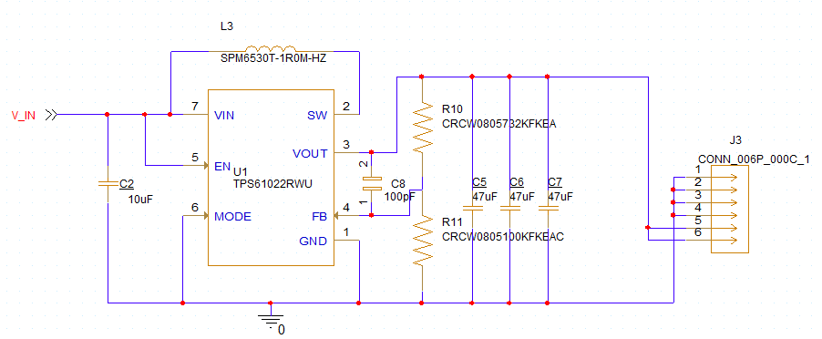
Schematic and layout design

Slide 12

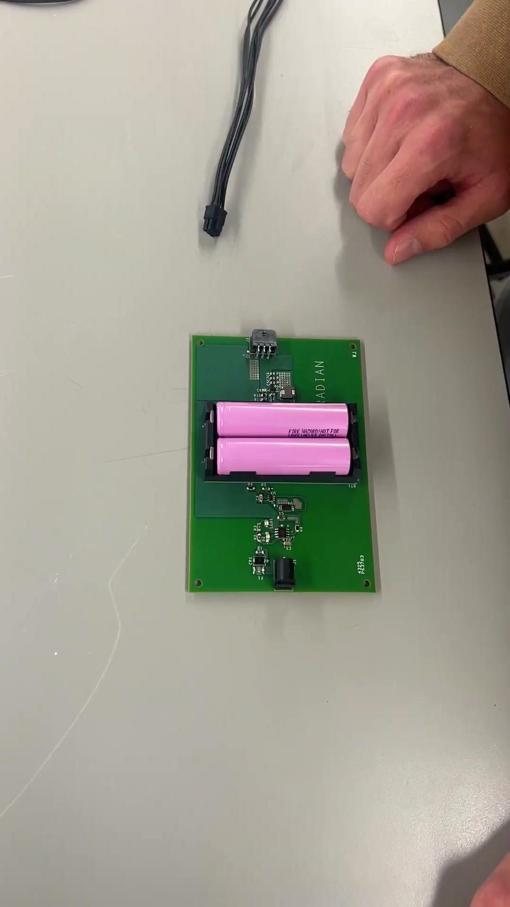
Video Demos

Slide 13
5V Output Voltage vs Load
Load Testing & System Validation
Used a Raspberry Pi as a real system load to validate the power board under practical conditions
No-load output measured at 5.07 V to verify proper regulation
With Raspberry Pi connected, output measured at ~4.92 V
Voltage remained within the acceptable 5 V tolerance range
Demonstrates the board can power real hardware, not just ideal loads
Confirms stable operation under a dynamic and “real-world” load
Validates that the power PCB is functional for system-level use

Slide 14
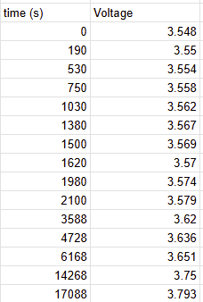
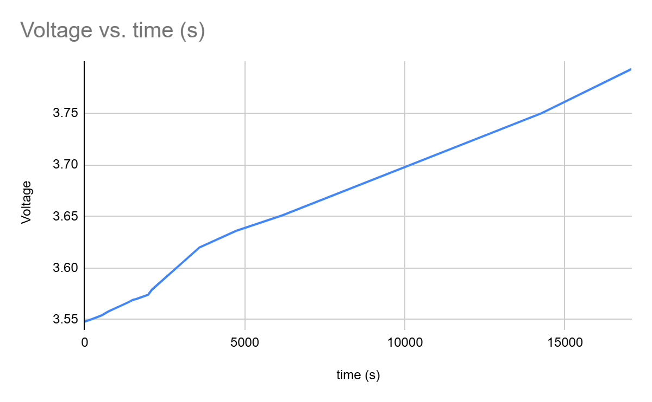
Battery Voltage vs Time for Charging

Slide 15
Physical Technical Merit
Built-in Li-ion battery charging circuit for safe, on-board charging
Boost converter generates regulated 5 V output from the battery
Successfully powers a Raspberry Pi
Tested the output with resistor loads
Board supports charging and powering the system at the same time
Stable operation with no shutdown or instability during testing
Design provides a solid baseline for higher-current future revisions

Slide 16
Wireless Subsystem Overview
Radar + Mobile App:
Provides non-contact fall detection using mmWave radar
Converts radar point cloud data into usable features for Data subsystem
Delivers real time alerts and fall logs to caregivers through mobile app (simulated alerts)
Radar (AWR6843ISK)
Raspberry Pi 3
Mobile App

Slide 17
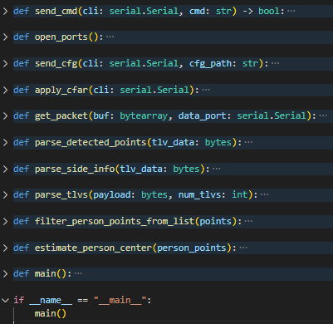
Radar Technical Merit
Radar data acquisition + preprocessing pipeline:
Python pipeline configures TI AWR6843ISK using custom .cfg
Uses dual UART: CLI (115200 bps) + Data (921600 bps)
Parses Type-Length-Value (TLV) frames into x, y, z, and velocity point cloud
Supports real time human tracking by extracting position and velocity features
Outputs clean NDJSON to Data subsystem for classification
Built in handling for frame boundaries, device echo, and binary parsing

Slide 18
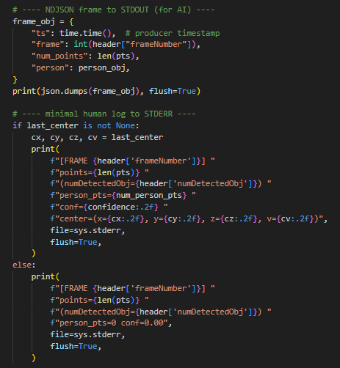

Radar Demo
NDJSON output:
Human Tracking:

Slide 19
Radar Validation & Test Cases
Functional Testing: Frame integrity, TLV decoding, UART throughput
Scenario Testing: Walking, standing, falling motions, no-motion cases
Velocity Testing: Toward/away motion to verify Doppler sign
Range Testing: Close range vs. max range behavior
Noise & Clutter: Verified point counts and spatial consistency

Slide 20
Mobile App Technical Merit
Flutter based Android app
Tabs: Home, Alerts, Fall Log, Settings
Implements periodic reminders and simulated fall events
Implements Gotify connection UI and backend logic (integration for 404)
Stores weekly fall events in local data
User selectable Light/Dark Theme
Settings tab configures Gotify connection

Slide 21
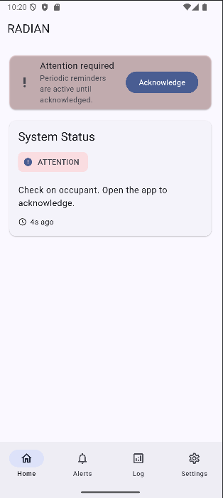
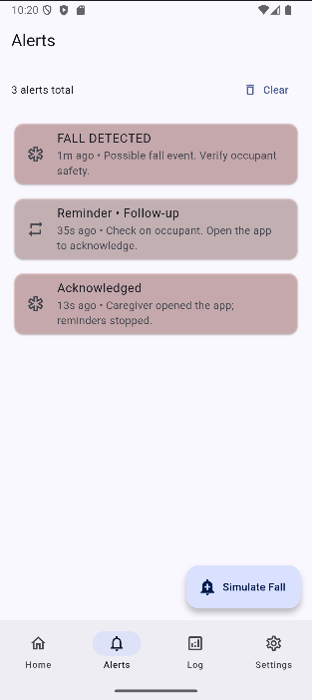
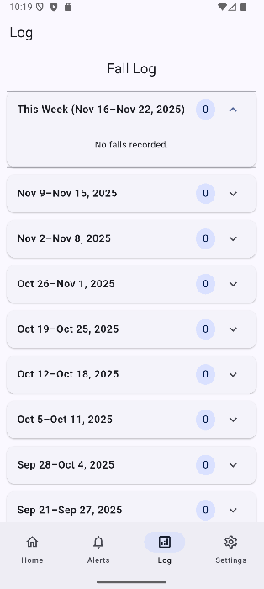
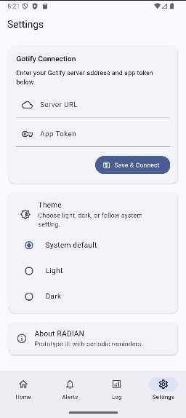
Mobile App Demo

Slide 22
Mobile App Validation & Test Cases
Verified navigation across Home, Alerts, Log, and Settings
Tested simulated fall alerts, reminders, and acknowledgement flow
Theme selector (Light/Dark) fully functional
Gotify to Fall log pipeline implemented in code; live server testing planned for integration in 404

